Slide 1

Observables: Operators and Subjects/BehaviorSubject
Curs 7:

Slide 2
Evolution of Asynchronous
JavaScript – RxJS Operators
create observables: of, interval, empty, from, fromEvent
manipulate observables: map, mergeMap, switchMap, concatMap
filter observables: filter, first, skip, take, debounceTime
error handling: catch/catchError, retry
combination: forkjoin, combineLatest
utility: do/tap, toPromise

Slide 3
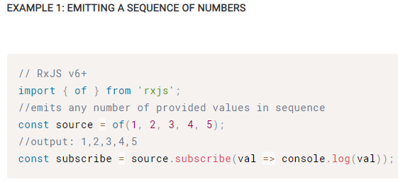
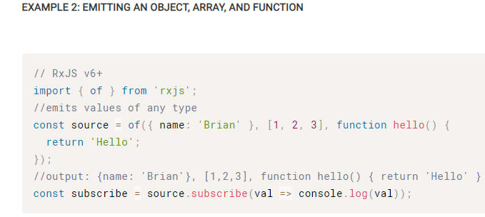
RxJS Operators - of signature: of(...values, scheduler: Scheduler): Observable Emit variable amount of values in a sequence and then emits a complete notification.

Slide 4
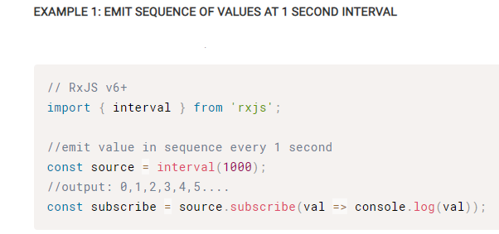
RxJS Operators - interval signature: interval(period: number, scheduler: Scheduler): Observable
Emit numbers in sequence based on provided timeframe.

Slide 5
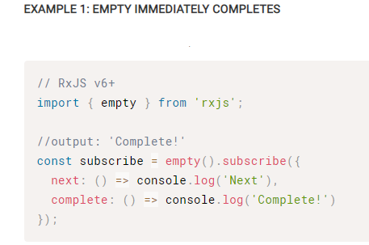
RxJS Operators - empty signature: empty(scheduler: Scheduler): Observable
Observable that immediately completes.

Slide 6
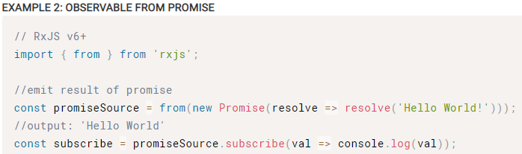
RxJS Operators - from signature: from(ish: ObservableInput, mapFn: function, thisArg: any, scheduler: Scheduler): Observable
Turn an array, promise, or iterable into an observable.
This operator can be used to convert a promise to an observable!

Slide 7
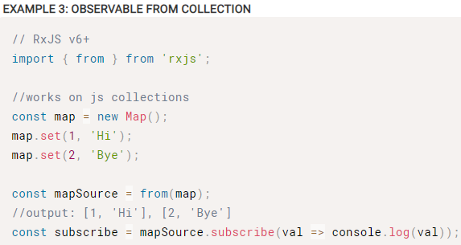
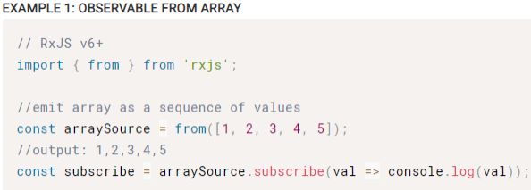
RxJS Operators - from signature: from(ish: ObservableInput, mapFn: function, thisArg: any, scheduler: Scheduler): Observable
Turn an array, promise, or iterable into an observable.
For arrays and iterables, all contained values will be emitted as a sequence!

Slide 8
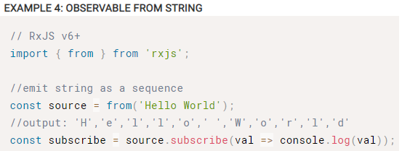
RxJS Operators - from signature: from(ish: ObservableInput, mapFn: function, thisArg: any, scheduler: Scheduler): Observable
Turn an array, promise, or iterable into an observable.
This operator can also be used to emit a string as a sequence of characters!

Slide 9
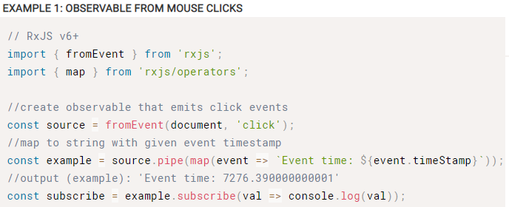
RxJS Operators - fromEvent signature: fromEvent(target: EventTargetLike, eventName: string, selector: function): Observable
Turn event into observable sequence.

Slide 10
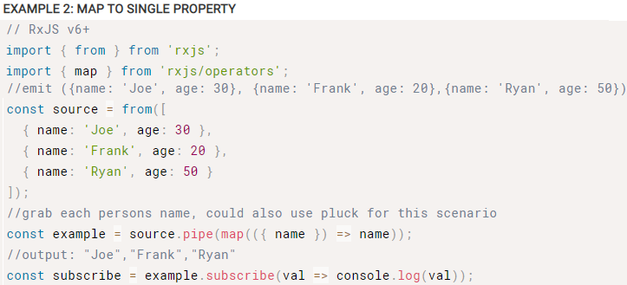
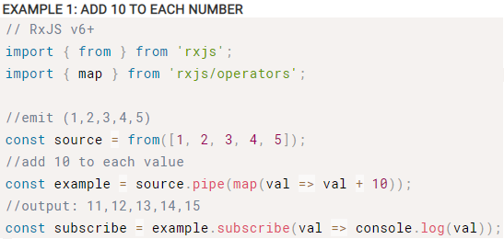
RxJS Operators - map signature: map(project: Function, thisArg: any): Observable
Apply projection with each value from source.

Slide 11
RxJS Operators - mergeMap signature: mergeMap(project: function: Observable, resultSelector: function: any, concurrent: number): Observable
Map to observable, emit values.
flatMap is an alias for mergeMap!
If only one inner subscription should be active at a time, try switchMap!
If the order of emission and subscription of inner observables is important, try concatMap!

Slide 12
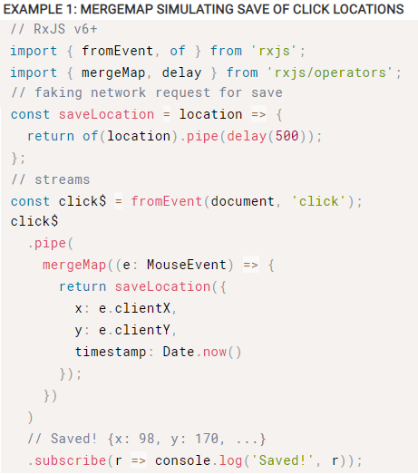
RxJS Operators - mergeMap signature: mergeMap(project: function: Observable, resultSelector: function: any, concurrent: number): Observable

Slide 13
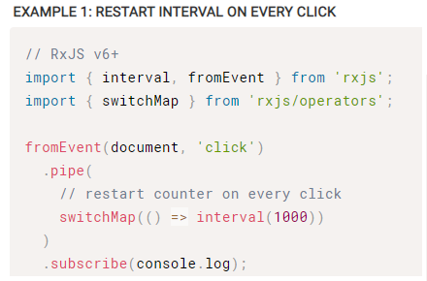
RxJS Operators - switchMap signature: switchMap(project: function: Observable, resultSelector: function(outerValue, innerValue, outerIndex, innerIndex): any): Observable
Map to observable, complete previous inner observable, emit values.

Slide 14
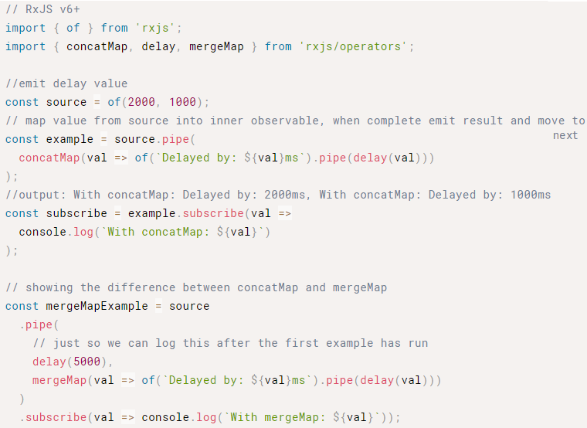
RxJS Operators - concatMap signature: concatMap(project: function, resultSelector: function): Observable
Map values to inner observable, subscribe and emit in order.

Slide 15
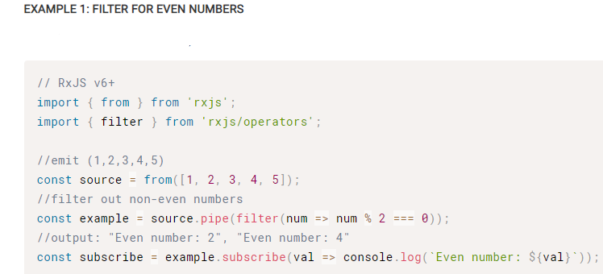
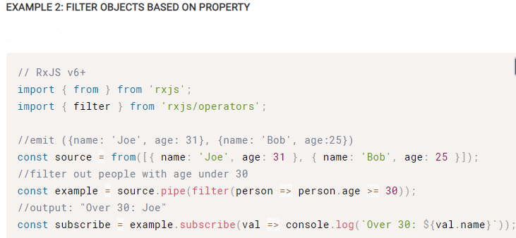
RxJS Operators - filter signature: filter(select: Function, thisArg: any): Observable
Emit values that pass the provided condition.

Slide 16
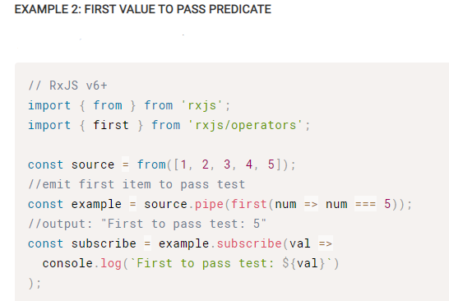
RxJS Operators - first signature: first(predicate: function, select: function)
Emit the first value or first to pass provided expression.

Slide 17
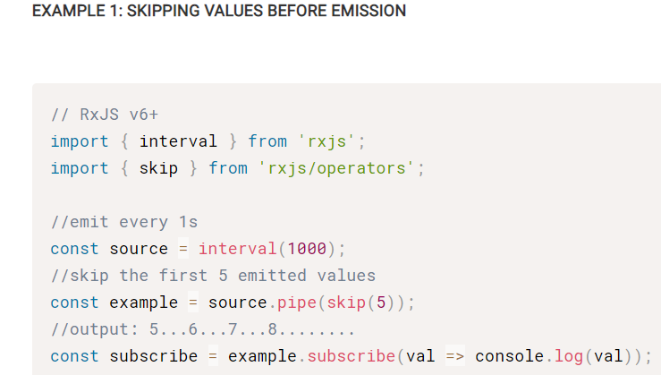
RxJS Operators - skip signature: skip(the: Number): Observable
Skip the provided number of emitted values.

Slide 18
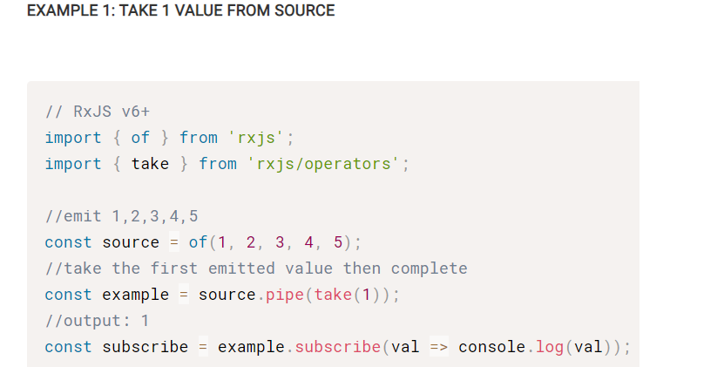
RxJS Operators - take signature: take(count: number): Observable
Emit provided number of values before completing.

Slide 19
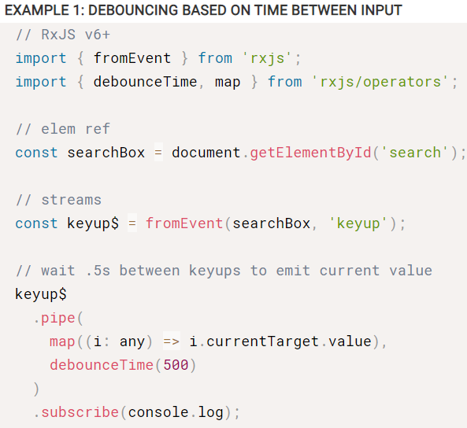
RxJS Operators - debounceTime signature: debounceTime(dueTime: number, scheduler: Scheduler): Observable
Discard emitted values that take less than the specified time between output

Slide 20
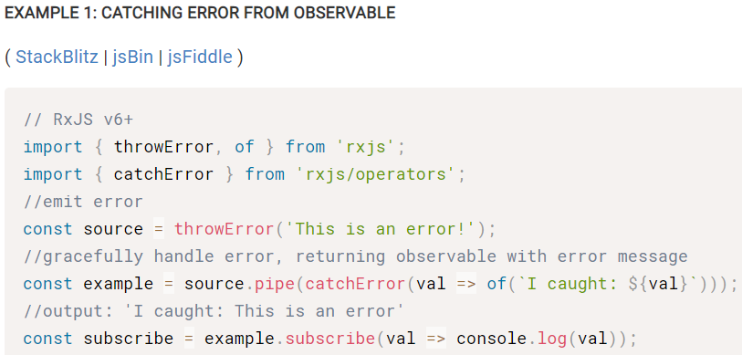
RxJS Operators - catch / catchError signature: catchError(project : function): Observable
Gracefully handle errors in an observable sequence.

Slide 21
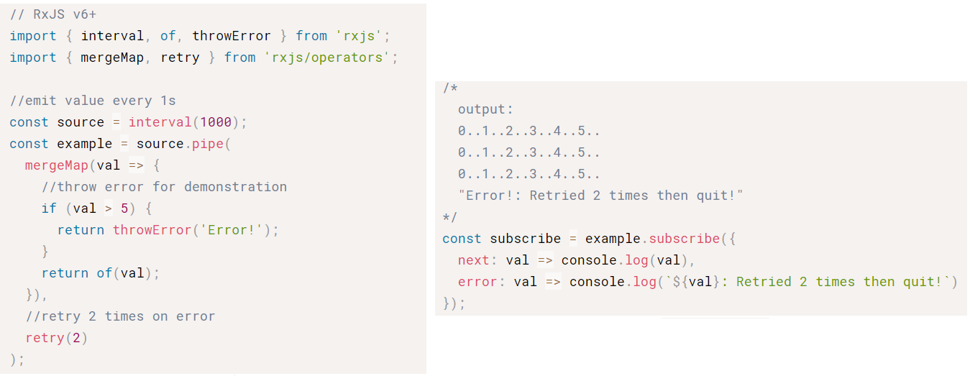
RxJS Operators - retry signature: retry(number: number): Observable
Retry an observable sequence a specific number of times should an error occur.

Slide 22
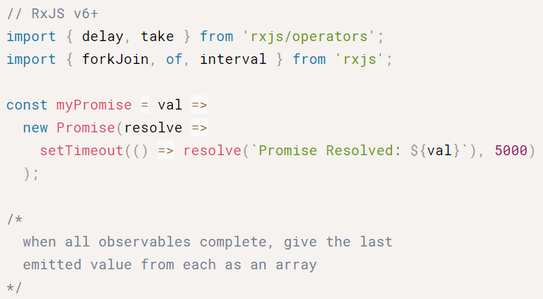
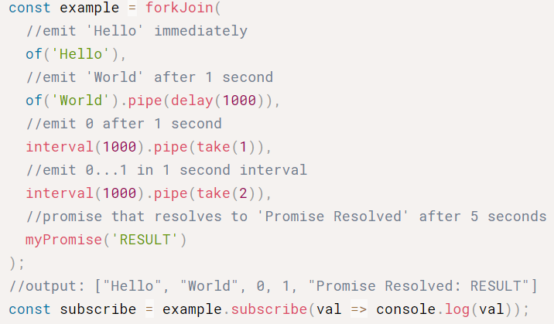
RxJS Operators - forkJoin signature: forkJoin(...args, selector : function): Observable
When all observables complete, emit the last emitted value from each.

Slide 23
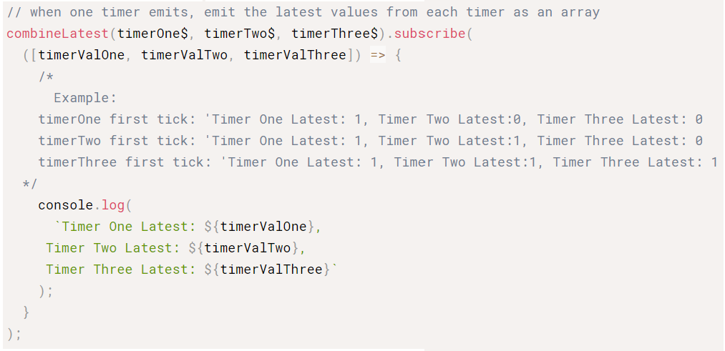
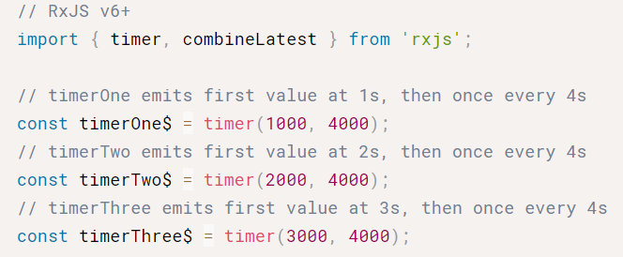
RxJS Operators - combineLatest signature: combineLatest(observables: ...Observable, project: function): Observable
When any observable emits a value, emit the last emitted value from each.

Slide 24
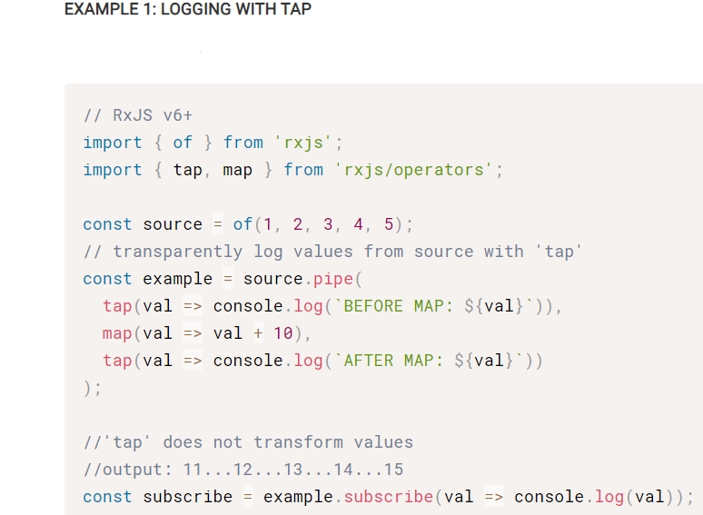
RxJS Operators – tap/do signature: tap(nextOrObserver: function, error: function, complete: function): Observable
Transparently perform actions or side-effects, such as logging.

Slide 25
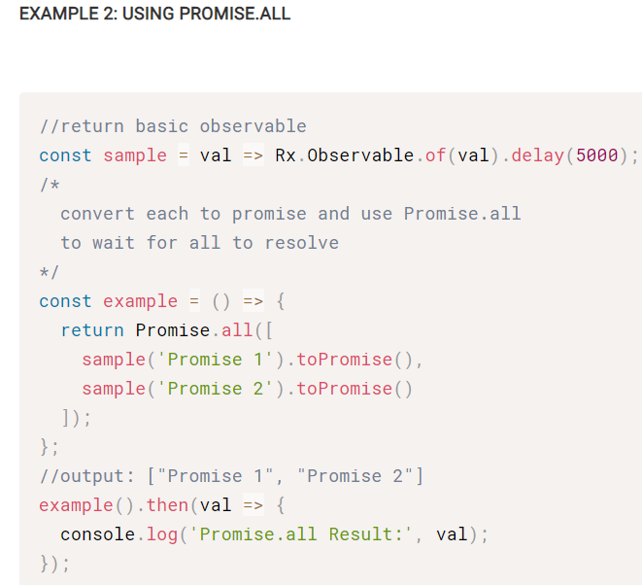
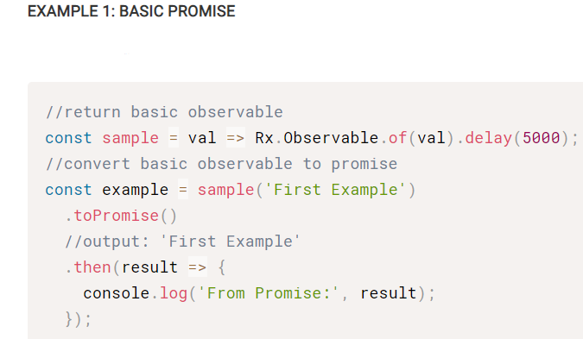
RxJS Operators – toPromise signature: toPromise() : Promise
Convert observable to promise.

Slide 26
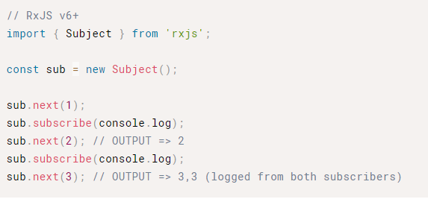
Subject A special type of Observable which shares a single execution path among observers

Slide 27
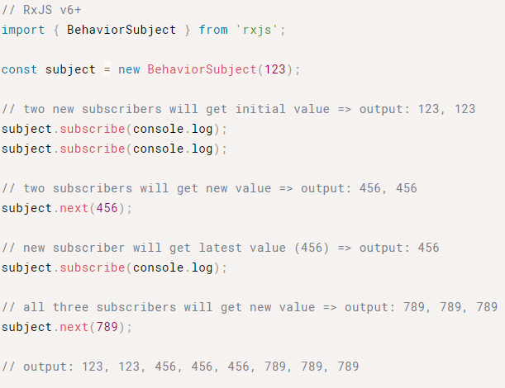
BehaviorSubject
Requires an initial value and emits the current value to new subscribers

Slide 28
References
https://rxjs-dev.firebaseapp.com/api
https://rxjs-dev.firebaseapp.com/operator-decision-tree
https://www.learnrxjs.io/

